Slide 1


Bridging the Gap: Connecting Flutter Apps to the Backend
A practical guide to seamless data exchange and robust app functionality​
Notes:
Hello everyone Welcome to Aitrich Technologies, In this presentation, we will delve into the world of Connecting Flutter Apps to the Backend. We will cover Networking in Flutter, API Methods, Rest API Integration, JSON Mastery Handling Data Exchange, Rest API Components, Firebase Integration: Cloud-Powered Features, GraphQL in Flutter and Security Considerations for Back-end Integration.

Slide 2
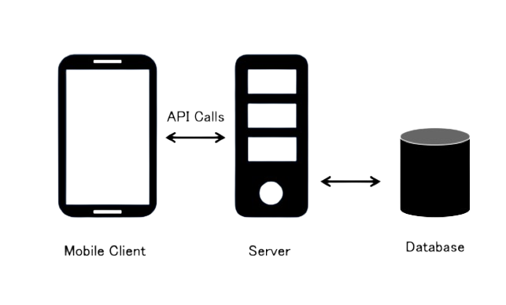
Networking in Flutter: Laying the Foundation​
Overview of networking concepts and tools in Flutter​
HTTP protocol and its role in mobile app communication​
Introducing the http package for making HTTP requests​
Understanding Futures and async/await for asynchronous networking​
Making HTTP requests with the http package
Constructing basic GET, POST, PUT, and DELETE requests​
Sending headers and data along with requests​
Handling different HTTP response codes
Handling responses and errors gracefully
Parsing JSON responses into Dart objects​
Dealing with network errors and timeouts​
Implementing responsive UI based on network outcomes
Notes:
So, Let us Discuss Networking in Flutter, It refers to the process of establishing communication between your app and external services or APIs over the internet. It's a crucial aspect for fetching data, sending information, and enabling various functionalities. Here's a breakdown of the foundation:
Key Concepts:
HTTP Requests: You'll use methods like GET, POST, PUT, and DELETE to interact with APIs. Libraries like http and dio simplify this process.
Data Formats: APIs typically respond with JSON or XML data, which you need to parse and utilize within your app.
Error Handling: Network issues or API errors are common, so implementing robust error handling is essential.
Security: Protecting user data and ensuring secure communication through encryption and authentication is paramount.
Building Blocks:
Packages: Popular packages like http, dio, and flutter_secure_storage provide essential tools for making requests, handling responses, and securely storing data.
Authentication: You might need to implement methods like username/password login or OAuth to authorize your app for API access.
Caching: Caching frequently accessed data locally can improve performance and reduce server load.

Slide 3
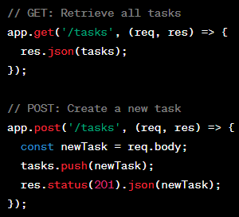
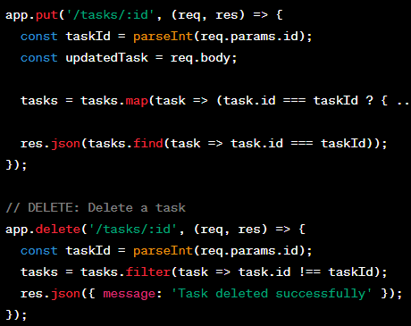
Api Methods​
GET: Retrieve data, safe and reversible.​
POST: Submit data for processing, not reversible.
PUT: Update or create a resource, reversible.​
DELETE: Remove a resource, reversible.​
Notes:
In this Slide We will study API Methods, There are classified into four types:
GET:
It's correct that GET retrieves data but not necessarily "safe" in all cases. Sensitive data should not be sent through GET requests as it becomes part of the URL and can be easily logged or exposed.
GET is considered "idempotent" because repeating the same request should have the same outcome (retrieving the same data).
POST:
While POST is often used for submitting data, it's not specifically for processing. It can also be used for creating new resources.
POST is generally NOT reversible, as submitting the same data repeatedly might create multiple resources or have unintended side effects.
PUT:
PUT is primarily used for updating existing resources, not creating new ones. However, some APIs might allow creating resources with PUT if they don't have an identifier yet.
PUT is considered idempotent, meaning repeating the same request with the same data should result in the same updated resource.
DELETE:
DELETE is indeed used for removing resources, but it's generally NOT reversible. Once a resource is deleted, it's usually gone permanently.
DELETE is NOT idempotent, as repeating the same request would try to delete the same resource multiple times, leading to an error if it's already gone.

Slide 4
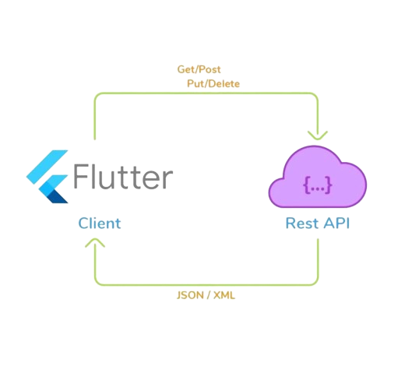
REST API Integration: Unlocking Data Potential​
Introduction to RESTful APIs and their working principles​
Understanding endpoints, resources, and representations​
Common HTTP verbs used in API interactions
Fetching data from REST APIs using GET requests​
Calling API endpoints to retrieve data in JSON format​
Processing and displaying retrieved data in the Flutter app​
Creating and updating data with POST and PUT requests​
Sending structured data to the API for creation or modification​
Handling success and error scenarios
Notes:
Fetching data with GET requests:
Used to retrieve existing data from an API endpoint.
Example: Getting a list of users from /users endpoint.
No body: GET requests typically don't include data in the request body.
Parameters: You can filter or specify data using query parameters in the URL (e.g., /users?id=123).
Response: Returns the requested data in the response body, usually formatted as JSON or XML.
Creating data with POST requests:
Used to create new data on the server.
Example: Creating a new user by sending user data to /users endpoint.
Data in body: The new data is included in the request body, often formatted as JSON or XML.
Endpoint design: The specific endpoint may differ (e.g., /users or /create-user).
Response: Usually returns a success message or information about the newly created resource (e.g., ID).
Updating data with PUT requests:
Used to modify existing data on the server.
Example: Updating a user's profile by sending updated data to /users/123 endpoint.
Data in body: The updated data is included in the request body, similar to POST.
Endpoint design: Usually targets the specific resource by ID (e.g., /users/123).
Response: Often returns a success message or the updated resource itself.

Slide 5

JSON Mastery: Handling Data Exchange​
Understanding JSON as the lingua franca of web data​
Recognizing key-value pairs and nested structures​
Interpreting different data types in JSON
Parsing JSON responses into usable Dart objects​
Utilizing libraries like json_serializable for automatic parsing​
Manually creating Dart objects from JSON data
Encoding Dart objects into JSON for transmission​
Converting complex Dart objects into JSON format​
Sending serialized JSON data to the API
Notes:
Understanding JSON as the Web Data lingua franca:
Lightweight and human-readable: JSON uses simple text format for easy exchange and understanding.
Widely adopted: Most web APIs use JSON for data interchange, making it ubiquitous.
Language-independent: Works seamlessly with various programming languages like Dart.
Structured data: Organizes data in key-value pairs and arrays, facilitating processing.
Parsing JSON responses into usable Dart objects:
Libraries: Use libraries like json_serializable or built_value for automatic parsing.
Manual parsing: Parse manually using dart:convert package for deeper control.
Mapping: Define classes in Dart that mirror the JSON structure for easy conversion.
Data types: Consider data types in Dart and JSON and handle conversions properly.
Encoding Dart objects into JSON for transmission:
Libraries: Similar libraries (json_serializable, built_value) provide encoding functionality.
Automatic: Generate JSON from Dart objects based on defined annotations.
Manual: Use dart:convert for custom encoding or specific needs.
Data types: Ensure compatibility between Dart data types and JSON representations.

Slide 6
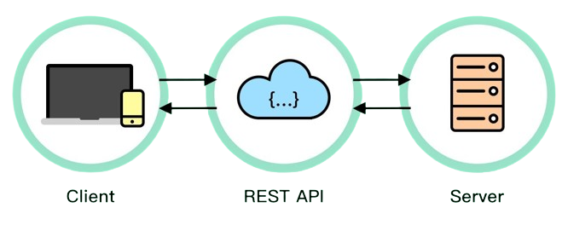
Rest Api Components​
URI (Uniform Resource Identifier):​
A string of characters that identifies a name or a resource on the Internet. It's a more generic term that includes both Uniform Resource Locators (URLs) and Uniform Resource Names (URNs).
URL (Uniform Resource Locator):​
A specific type of URI that provides the means to locate a resource on the internet, specifying its protocol, domain, path, etc.
Notes:
URI (Uniform Resource Identifier):
This is the most general term, acting as a unique identifier for a resource on the internet. It can include both the location (URL) and additional information about the resource itself.
Think of it like a street address with apartment number: https://example.com/articles/123#comments. Here, "<invalid URL removed>" is the URL (location) and "#comments" specifies a particular section within the article.
2. URL (Uniform Resource Locator):
This is a specific type of URI that focuses on locating a resource. It specifies the protocol (e.g., https, http), domain name, and path to access the resource.
In the example above, "<invalid URL removed>" is the URL that identifies the location of the article.

Slide 7
Headers
Part of an HTTP request or response that carries metadata in key-value pairs. Headers provide information about the message, such as the content type or authorization details.
Body
The payload of an HTTP request or response, containing the data being sent or received. In the context of a request, the body often contains information like form data or JSON payloads.
Params (Parameters)
Parameters are additional values provided in an HTTP request, usually as part of the URL query string (for GET requests) or in the request body (for POST requests). They are used to pass information to the server.
Notes:
Headers:
These are additional pieces of information attached to a request or response. They provide context and instructions for the communication.
Imagine sending a package with a label (URL) and attaching notes specifying preferred delivery method, recipient information, etc. (headers).
Examples of headers: authentication tokens, language preferences, content type (e.g., JSON, XML).
Body:
This refers to the main content of a request or response, carrying the actual data being sent or received.
In our package analogy, this would be the contents of the box itself, carrying the goods being delivered.
Examples: Data being submitted to create a new user (POST request), retrieved article content (GET response).
Params (Parameters):
These are specific key-value pairs that further refine the request or response, providing additional details or filtering criteria.
Think of them like labels attached to specific items within the package, specifying quantity, size, or other relevant information.
Examples: Search query parameters in a URL (e.g., https://example.com/search?q=cats), pagination parameters in API requests (e.g., page=2).

Slide 8
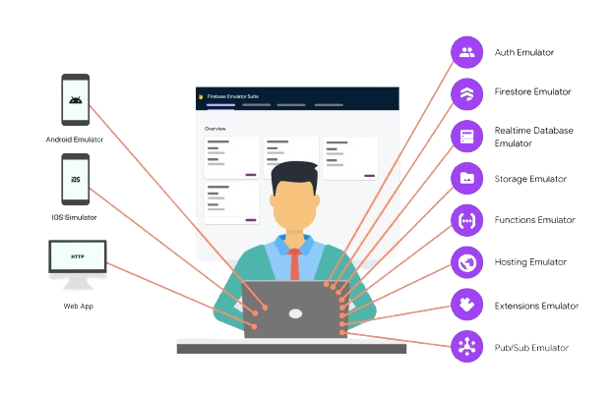
Firebase Integration: Cloud-Powered Features​
Introducing Firebase as a comprehensive backend platform for Flutter​
Benefits of using Firebase for authentication, database, storage, and more
Authentication: Sign-in, user management, and security​
Implementing email/password, social login, and anonymous authentication​
Managing user accounts and permissions
Realtime Database: Synchronizing data in real-time for dynamic updates​
Storing and retrieving data with automatic updates across devices​
Building interactive and responsive features in your app
Cloud Storage: Storing and serving user-generated content​
Securely storing images, videos, and other files​
Delivering content efficiently to users
Notes:
Authentication:
Easily implement various authentication methods (email/password, social logins, phone number) with robust security measures.
Manage user accounts, send password resets, and enforce secure authentication flows.
Real-time Database: A realtime database with offline capabilities, suitable for data that needs to be instantly accessible and synchronized across devices.
Cloud Storage:
Securely store user-generated content like images, videos, and other files in Google Cloud Storage.
Serve files efficiently with a global Content Delivery Network (CDN) for fast loading times and reduced latency.

Slide 9
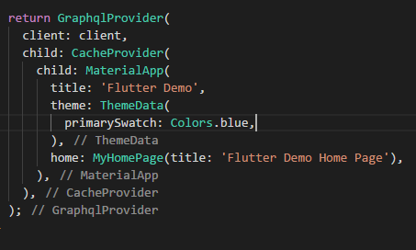
GraphQL in Flutter:
A Modern Query Approach​
Exploring GraphQL as an alternative to REST for efficient data fetching​
Declaring specific data requirements through queries​
Fetching only the data needed, reducing over-fetching
Setting up GraphQL clients in Flutter​
Popular libraries like apollo_flutter for interacting with GraphQL APIs​
Configuring the client with endpoint URL and authentication details
Writing GraphQL queries to request specific data​
Specifying fields and relationships to retrieve from the API​
Building complex queries with nesting and filtering
Handling GraphQL responses and integrating data into UI​
Parsing responses into Dart objects based on defined types​
Updating UI components with retrieved data
Notes:
Exploring GraphQL as an alternative to REST for efficient data fetching
REST limitations: Over-fetching or under-fetching data, multiple endpoints, rigid structure.
GraphQL advantages:
Precise data requests: Get only the data you need, no more, no less.
Single request: Combine data from multiple sources in a single query.
Flexibility: Evolve schema without breaking clients, query complex data structures.
Setting up GraphQL clients in Flutter
Popular libraries: apollo_client, graphql_flutter.
Easy integration: Follow library documentation and connect to your GraphQL server.
Benefits: Manage queries, mutations, subscriptions, handle responses seamlessly.
Writing GraphQL queries to request specific data
Schema knowledge: Understand your GraphQL schema to write effective queries.
Field selection: Specify the exact fields you need for each object.
Nesting and arguments: Combine fields, filter data with arguments.
Fragments: Reusable subqueries for common data patterns.
Handling GraphQL responses and integrating data into UI
Parse responses: Use provided libraries or custom logic to convert response data.
State management: Integrate data into your Flutter app's state management solution.
UI updates: Rebuild UI components based on the received data.

Slide 10
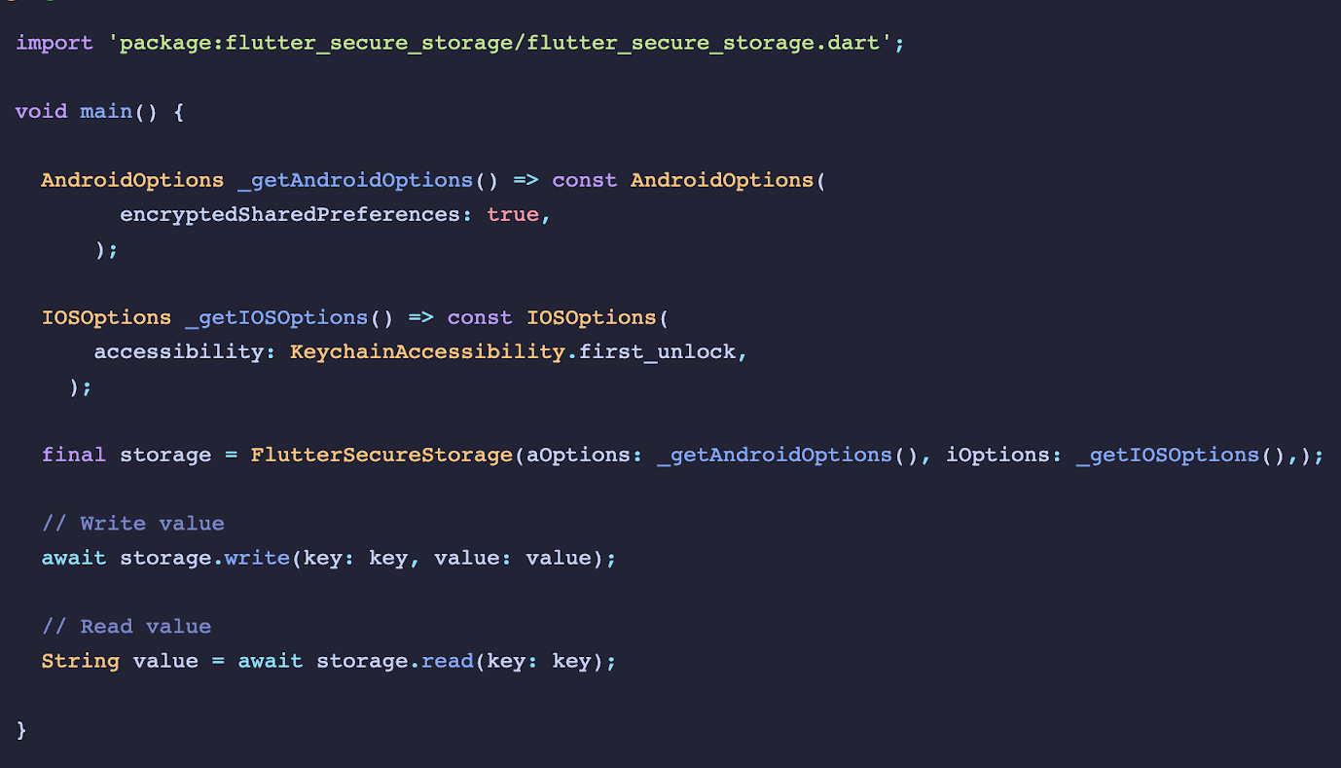
Security considerations for backend integration​
​
​
Secure data transmission with HTTPS​
User authentication and authorization best practices​
Error handling and data validation
Notes:
Secure Data Transmission with HTTPS:
HTTPS encrypts data: This protects sensitive information (passwords, tokens) from being intercepted during transmission.
Server authentication: HTTPS verifies the server's identity using SSL/TLS certificates, preventing man-in-the-middle attacks.
Data integrity: HTTPS ensures data hasn't been tampered with during transmission.
Implement best practices: Use strong cipher suites, update certificates regularly, and configure secure headers (HSTS, CSP).
User Authentication and Authorization Best Practices:
Strong passwords: Enforce strong password policies (minimum length, character types) and consider multi-factor authentication (MFA).
Least privilege: Grant users only the minimum access permissions needed for their roles.
Session management: Implement secure session management with timeouts and inactivity checks.
Regular reviews: Periodically review user access and permissions to ensure they remain appropriate.
Stay updated: Follow industry best practices and keep authentication mechanisms up-to-date.
Error Handling and Data Validation:
Validate user input: Validate all user input on the client-side and server-side to prevent malicious attacks and incorrect data processing.
Handle errors gracefully: Provide informative error messages without exposing sensitive information.
Log errors effectively: Log errors with relevant details for debugging and security analysis.
Prioritize security: Don't return detailed error messages that could be exploited by attackers.
Test thoroughly: Test your error handling and data validation under various scenarios to ensure robustness.

